Slide 1
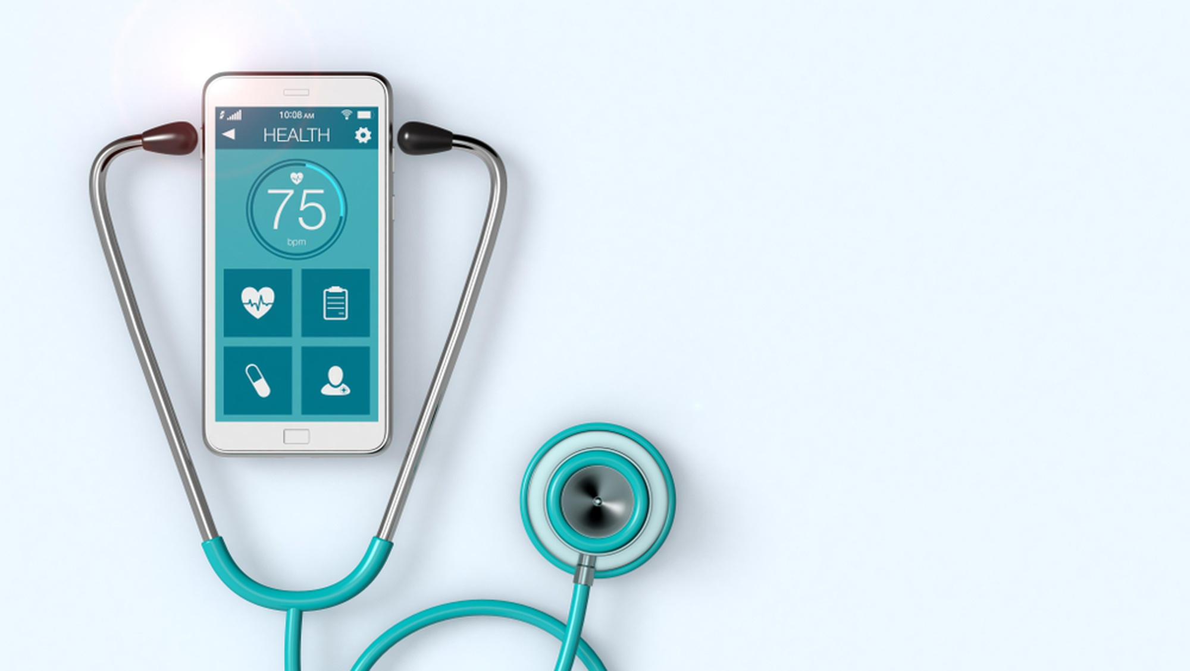
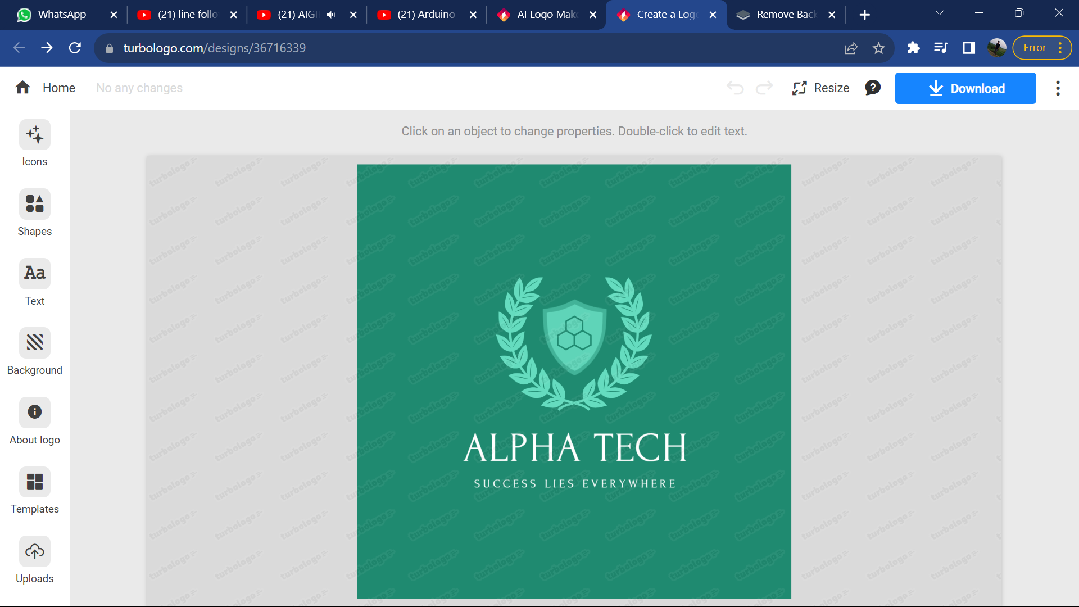
PATIENT REMOTE MONITORING SYSTEM

Slide 2

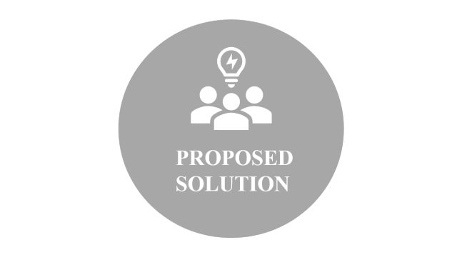

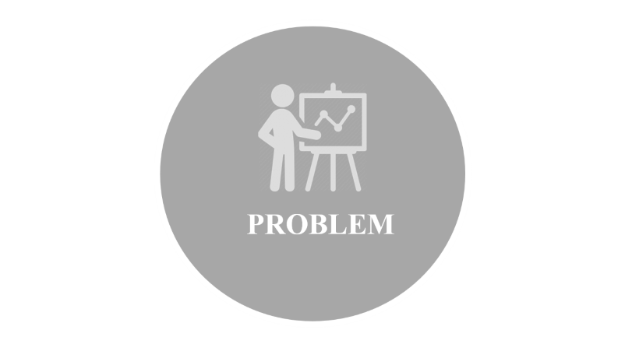

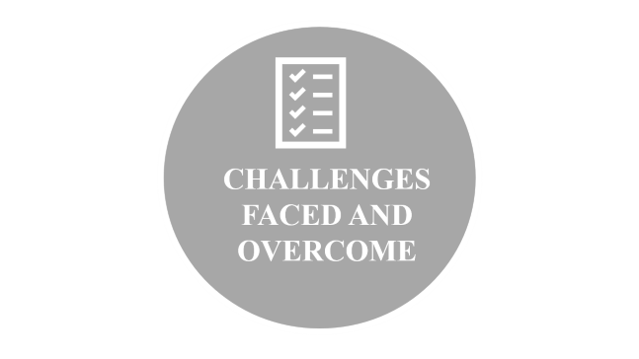
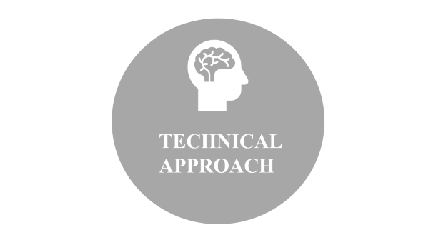



Slide 3

PROBLEM

Slide 4
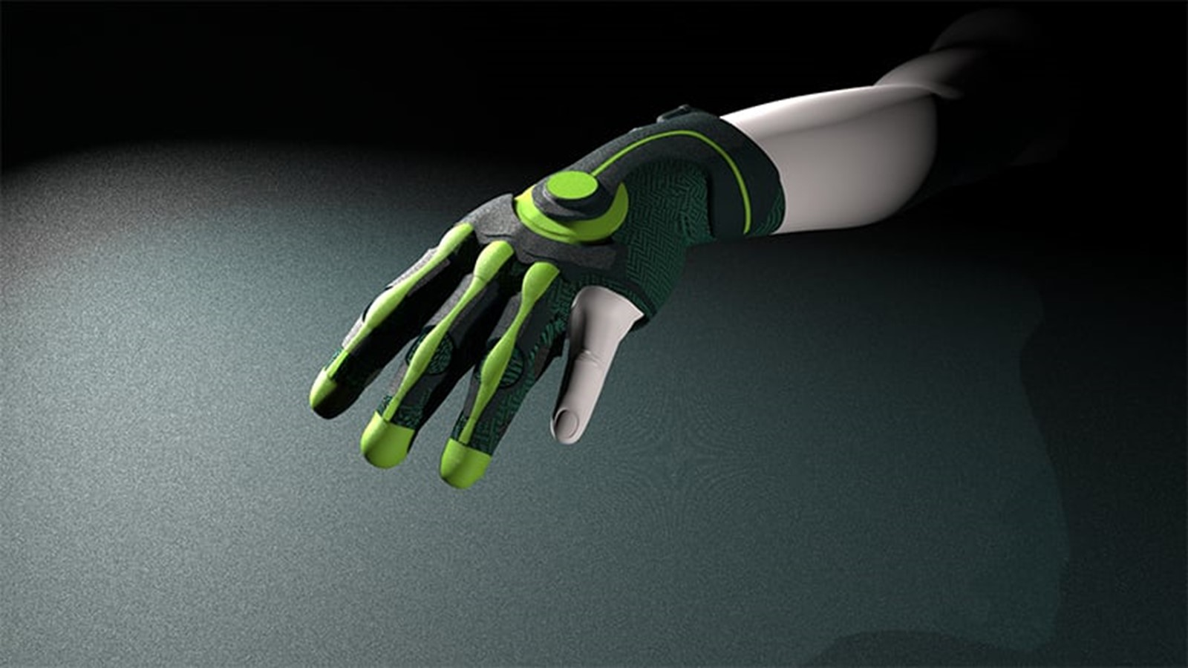
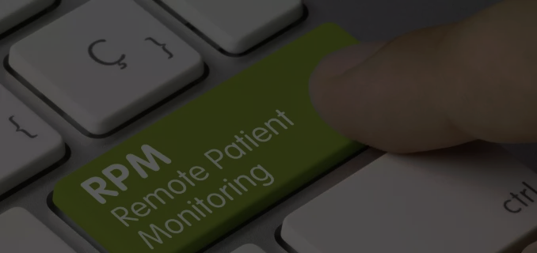
PROBLEM
The healthcare industry is confronted with the challenge of ensuring timely and accurate patient monitoring, which is crucial for effective medical intervention. The current monitoring systems often lack seamless integration and real-time data accessibility, hindering healthcare professionals from making informed decisions promptly. In addition, patients with chronic conditions or those requiring continuous monitoring face limitations in mobility and comfort. Simultaneously, there is a growing need for innovative solutions to enhance the interaction between patients and healthcare providers.

Slide 5

PROPOSED SOLUTION

Slide 6
PROPOSED SOLUTION
The proposed Smart Patient Monitoring System and Smart Glove aim to address these issues by leveraging advanced sensor technologies and real-time data processing. The system will enable continuous monitoring of vital signs and other relevant health parameters, providing healthcare professionals with immediate access to critical information. The Smart Glove enhances patient comfort and mobility by integrating monitoring capabilities into a wearable device. Together, these solutions strive to revolutionize patient care, fostering proactive healthcare management and improving overall patient outcomes.

Slide 7

TECHNICAL APPROACH

Slide 8
TECHNICAL APPROACH
HARDWARE COMPONENTS:
1.Arduino Microcontroller: ESP32 Micro Controller serve as the central processing unit for data collection and communication.
2.Sensors: Various sensors are connected to the Arduino to capture patient data. Common sensors include:
Heart rate monitor (e.g., pulse sensor)
2. Air quality sensor.
3. Temperature, humidity sensor(e.g., DS18B20)
4. Pulse oximeter for oxygen saturation (e.g., MAX30100)
3.Communication Module: To transmit data remotely, you can use:
Wi-Fi module (e.g., ESP8266 or ESP32) for internet connectivity.
2. Bluetooth module for short-range communication

Slide 9
TECHNICAL APPROACH
SOFTWARE COMPONENTS:
Arduino IDE: To upload the Arduino code using the Arduino Integrated Development Environment (IDE).
2.Cloud services- Arduino IOT cloud.
3.Streamlit using Python.
4.Machine Learning.

Slide 10
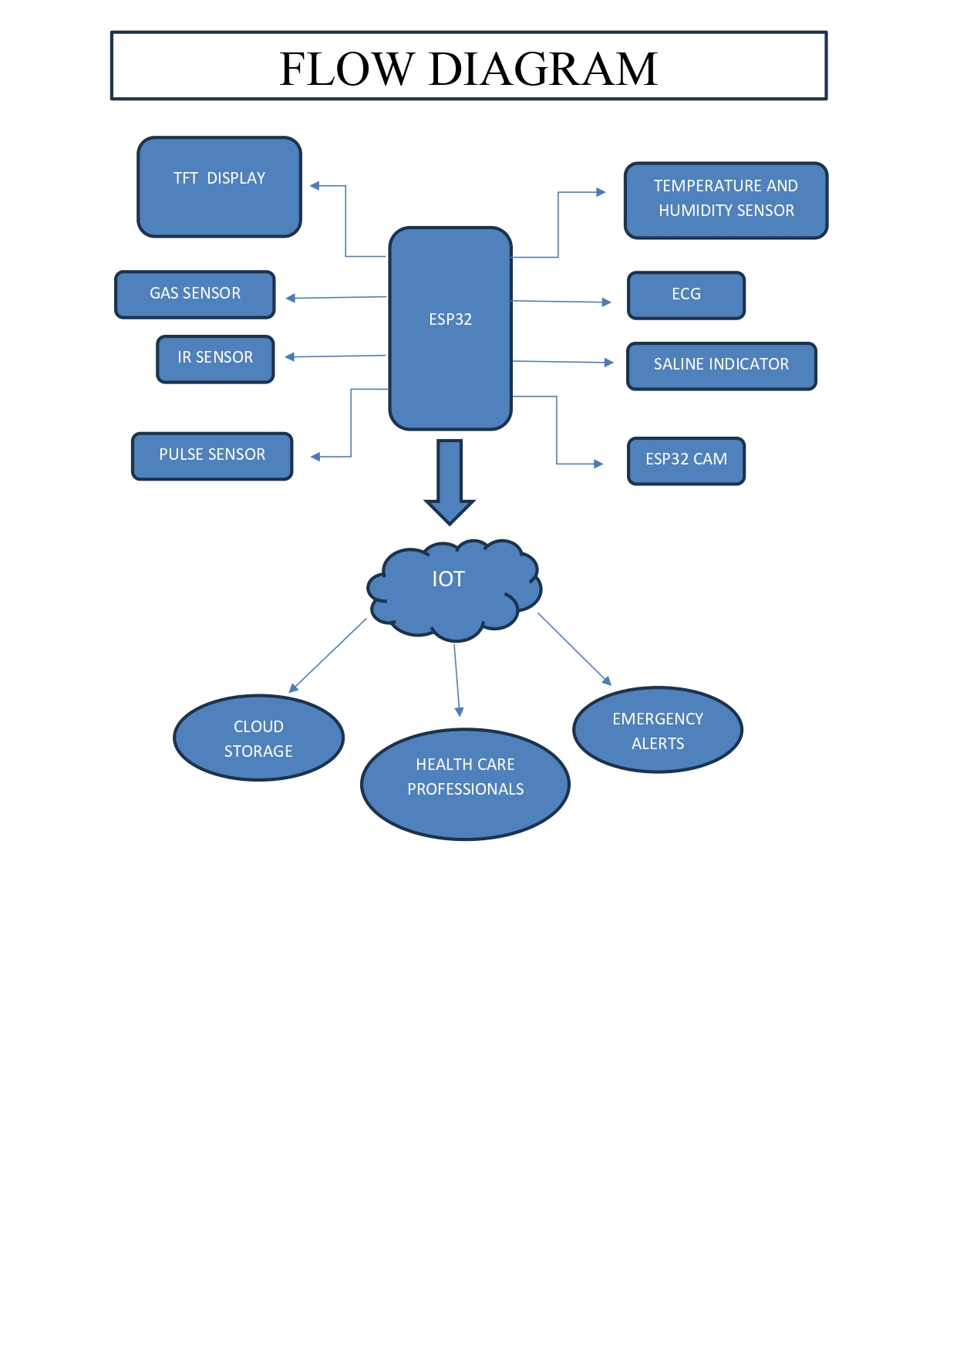

Slide 11
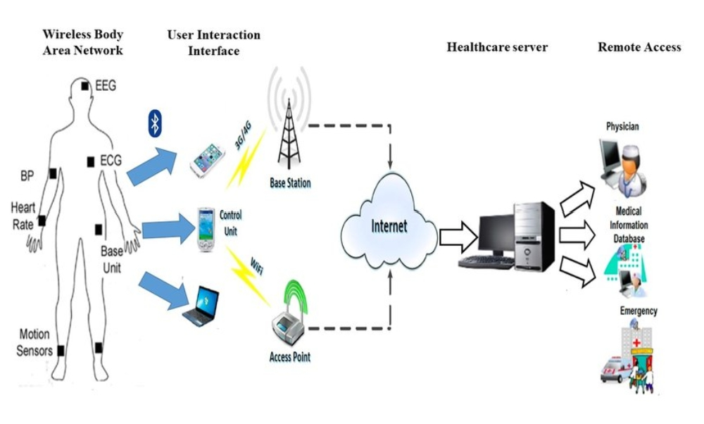

Slide 12

KEY FEATURES
&
FUNCTIONALITY

Slide 13
KEY FEATURES & FUNCTIONALITY
DATA COLLECTION AND TRANSMISSION: The system should collect, encrypt, and transmit patient data securely to a centralized platform or cloud-based server for storage and analysis.
REAL-TIME MONITORING: Provide healthcare providers with a real-time dashboard displaying patients' vital signs, trends, and alerts. Allow for continuous monitoring of patients' health status.
ALERTS AND NOTIFICATIONS: Generate automated alerts and notifications for healthcare providers when vital signs or health parameters fall outside predefined safe ranges. Alerts can be delivered via email, SMS, or mobile app notifications.
MEDICATION MANAGEMENT: Remind patients to take medications on time and track medication adherence. Alert healthcare providers if a patient misses a dose or experiences adverse effects.
PATIENT ENGAGEMENT: Engage patients in their own healthcare by providing them with educational resources, health tips, and progress reports. Encourage healthy behaviors and lifestyle changes.

Slide 14
USER EXPERIENCE
1.PATIENTS:
SETUP AND ONBOARDING: Patients would start by receiving their wearable devices and instructions on how to use them. The onboarding process should be simple, with clear, easy-to-follow instructions.
COMMUNICATION: The system should facilitate easy communication between patients and healthcare providers, allowing patients to ask questions, report symptoms, or seek guidance.
2.HEALTHCARE PROFESSIONALS:
Data Accessibility: Healthcare providers should have secure access to patient data in real-time. The system should provide a clear overview of patient status and trends.
Alert Management: Healthcare professionals should receive alerts when patients' vital signs indicate potential issues. The system should facilitate prompt intervention when needed.
Customization: Healthcare providers may need the ability to customize alert thresholds and monitoring/health parameters based on individual patient needs and medical guidelines.

Slide 15
BUSINESS/ IMPACT POTENTIAL
1.COST SAVINGS: Remote patient monitoring can help healthcare providers reduce the costs associated with hospital readmissions and in-person visits. This can be especially attractive for healthcare systems looking to improve efficiency and reduce healthcare expenditures.
2.DEVICE SALES: Selling monitoring devices and kits to healthcare facilities, clinics, or individuals can be a revenue stream for businesses. These devices can be based on Arduino technology and can be tailored to specific patient needs.
4.PARTNERSHIPS: Collaborations with hospitals, healthcare providers, insurance companies, and telehealth platforms can open doors to large-scale adoption and distribution of the monitoring system.
5.REDUCED HOSPITALIZATIONS: By monitoring patients remotely, healthcare providers can reduce the need for frequent hospitalizations, freeing up healthcare resources for more critical cases.
6.INCREASED ACCESS TO CARE: Remote monitoring can provide healthcare access to individuals in remote or underserved areas, improving healthcare equity.
7.ENHANCED QUALITY OF LIFE: Patients can enjoy a better quality of life by staying in the comfort of their homes while still receiving high-quality care and support.

Slide 16
LITERATURE REVIEW

Slide 17
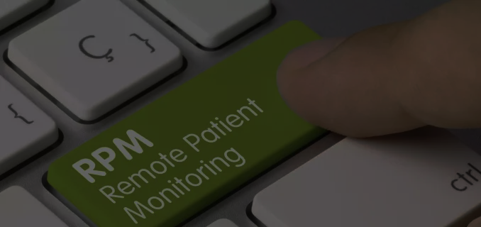
LITERATURE REVIEW
Growing body of research and development in the field of healthcare technology. These systems aim to improve patient outcomes, increase access to care, and reduce healthcare costs by enabling continuous monitoring and remote communication between patients and healthcare providers. Below, I summarize key findings from the literature on patient remote monitoring systems.
DEFINITION AND COMPONENTS: Patient remote monitoring systems are defined as technology-driven solutions that enable the collection of patient health data outside of traditional healthcare settings. These systems typically consist of wearable or implantable sensors, mobile apps, cloud-based platforms, and communication channels that connect patients with healthcare providers.
CHRONIC DISEASE MANAGEMENT: Many studies highlight the benefits of remote monitoring in managing chronic diseases, such as diabetes, hypertension, and heart failure. These systems provide real-time data on vital signs, medication adherence, and lifestyle factors, allowing for early intervention and personalized care plans.
POSTOPERATIVE CARE: Patient remote monitoring systems have been applied in postoperative care to track recovery progress and detect complications. They help reduce hospital readmissions, improve patient satisfaction, and enhance the overall quality of care.
ELDERLY CARE: The aging population has increased interest in remote monitoring for the elderly. These systems can assist in fall detection, medication reminders, and monitoring cognitive decline, enabling seniors to live independently while staying connected to healthcare providers.
MENTAL HEALTH: Remote monitoring systems have expanded to include mental health applications, such as monitoring mood, sleep patterns, and anxiety levels. These systems offer a way to provide timely interventions and support for individuals with mental health conditions.
DATA SECURITY AND PRIVACY: Ensuring the security and privacy of patient data is a significant concern. Researchers have emphasized the need for robust encryption, authentication mechanisms, and compliance with healthcare data regulations.

Slide 18
FUTURE DEVELOPMENT
&
ENHANCEMENT

Slide 19
FUTURE DEVELOPMENT &
ENHANCEMENT
1. INTEGRATION WITH AI AND MACHINE LEARNING:
To analyze patient data for early detection of diseases and personalized treatment recommendations.
2.TELEMEDICINE INTEGRATION:
Seamlessly integrate with telemedicine platforms to enable real-time video consultations with healthcare providers, fostering remote diagnosis and treatment.
3. WEARABLE TECHNOLOGY AND IOT:
Leverage wearable devices and IoT technology to expand continuous monitoring capabilities
4. ADVANCED SENSORS
Incorporate state-of-the-art sensors for additional vital sign monitoring, such as respiratory rate, glucose levels, or body posture, to provide a more comprehensive health profile.
5. REMOTE MEDICATION MANAGEMENT:
Integrate medication adherence monitoring and reminders to ensure patients take their medications as prescribed.

Slide 20
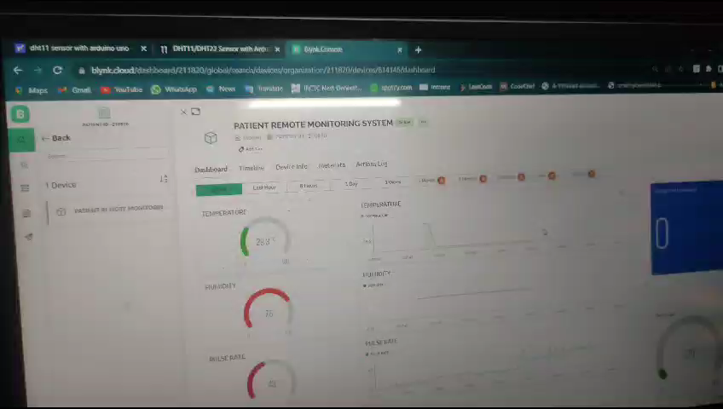
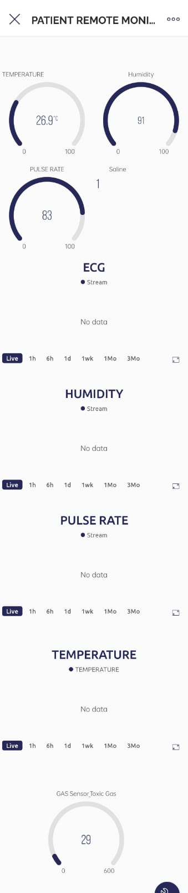
OUTPUT

Slide 21
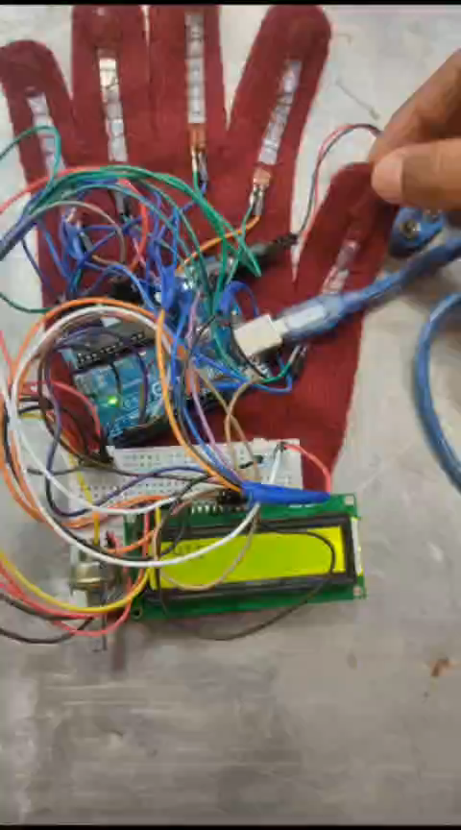
OUTPUT

Slide 22


